Slide 1

Bank Term Deposit Prediction
Marketing Campaign Analysis & Technical Implementation

Slide 2
Agenda
Project Overview
Dataset Analysis
Technical Implementation
Model Development
Results & Insights
Recommendations

Slide 3
Project Overview
Objective:
Predict term deposit subscriptions
Support Portuguese bank's marketing campaigns
Optimize phone-based outreach
Dataset:
45,211 records
17 attributes
Target: Term deposit subscription (Yes/No)

Slide 4
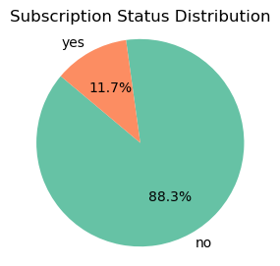
Dataset Analysis
Data Distribution:
No: 88.3%
Yes: 11.7%
Features:
7 Numerical Variables:
age, balance, duration, etc.
10 Categorical Variables:
job, marital, education, etc.

Slide 5
Data Preparation Steps
Initial
Initial Data Loading & Checks
Import data
Check for missing values
Examine data types
Engineering
Feature Engineering
Convert target variable
Apply one-hot encoding
Treating outliers

Slide 6
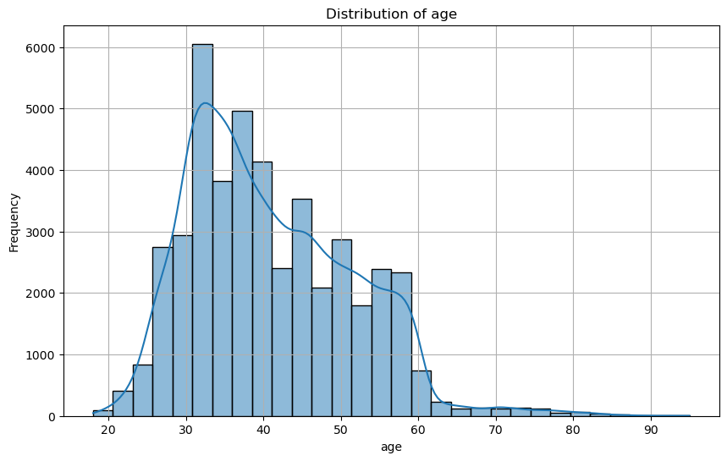
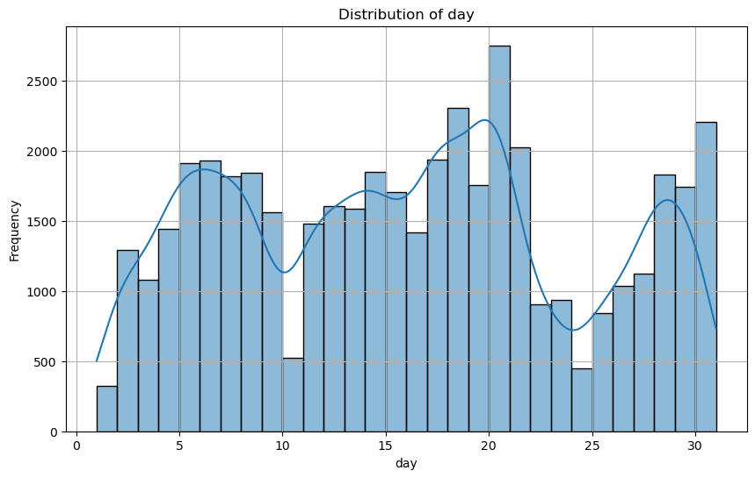
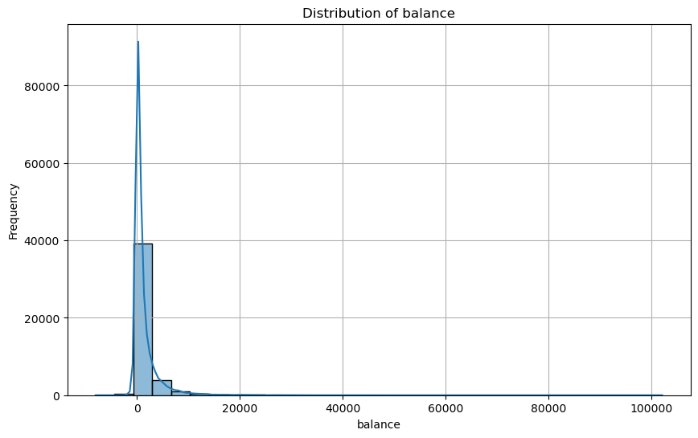
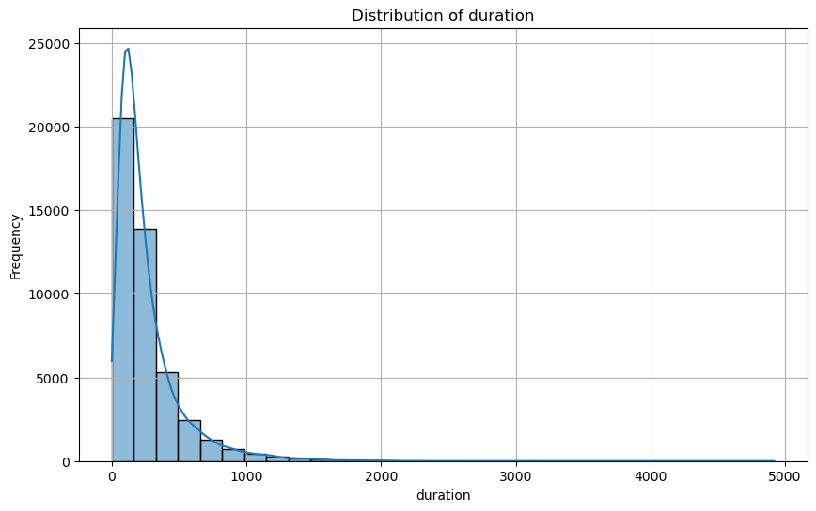
Exploratory Data Analysis
Insights:
Age shows positive skewness
Balance has significant outliers
Duration is key predictor
Campaign calls right-skewed

Slide 7
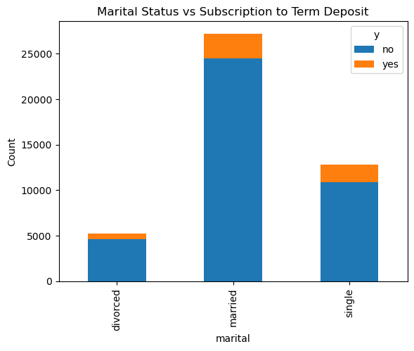
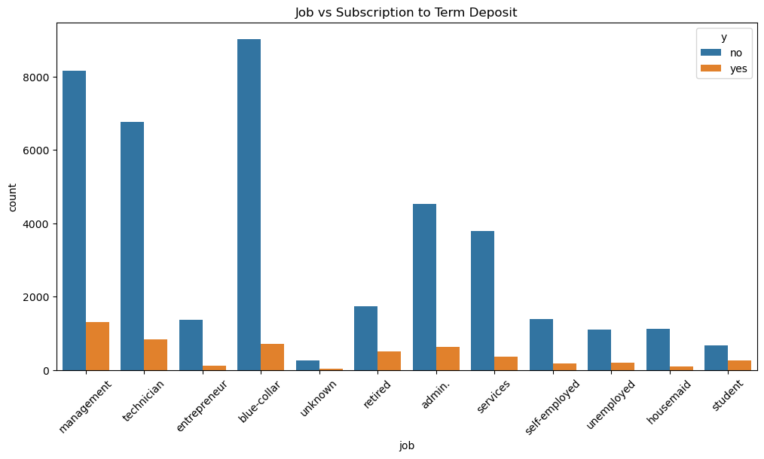

Feature Analysis
Key Findings:
Management: 24.6% of subscribers
Singles: Higher conversion rate
Previous success indicates higher likelihood

Slide 8

Technical Implementation
Data Preprocessing:
Outlier Treatment using IQR
Feature Scaling
Categorical Encoding
Model Pipeline:
Data splitting (80/20)
Cross-validation setup
Model training workflow

Slide 9
Model Development
Models Implemented:
Logistic Regression
Base model with default parameters
Hyperparameter tuning
Decision Tree
Maximum depth optimization
Minimum samples adjustment
Random Forest
Number of estimators: 100-500
Feature importance analysis

Slide 10
Baseline Results
Performance Metrics Table:
Model | Precision | Accuracy | Recall | F1 Score
Logistic Regression | 89.76% | 64.01% | 34.56% | 44.88%
Decision Tree | 87.13% | 46.62% | 46.20% | 46.41%
Random Forest | 90.15% | 66.13% | 37.58% | 47.93%

Slide 11
Final Model Results
After Tuning:
Model | Precision | Accuracy | Recall | F1 Score
Logistic Regression | 89.76% | 64.05% | 34.46% | 44.82%
Decision Tree | 87.96% | 50.11% | 43.08% | 46.33%
Random Forest | 90.01% | 66.21% | 36.94% | 47.16%

Slide 12
Feature Importance of Random Forest
remainder_duration(0.253) : Duration of the last call; longer calls often signal higher interest.
remainder_age (0.110): Age affects response rates; different engagement patterns based on age groups.
remainder_balance(0.107): Financial status indicated by balance influences product response likelihood.
Feature | Importance
remainder__duration | 0.253427
remainder__age | 0.110471
remainder__balance | 0.107056
remainder__day | 0.099616
cat__poutcome_success | 0.052403
remainder__campaign | 0.043299
cat__housing_yes | 0.024474
cat__contact_unknown | 0.014822
cat__education_secondary | 0.014691
cat__marital_married | 0.013743

Slide 13
Key Findings
Model Performance
Random Forest showed best overall results
High accuracy but lower recall across models
Default parameters performed well
Feature Importance
Duration strongest predictor
Previous success significant
Demographic factors moderate influence

Slide 14
Technical Recommendations
Engineering
Feature Engineering
Create interaction features
Apply sophisticated scaling
Develop custom features
Model
Model Improvements
Implement SMOTE for class imbalance
Try ensemble methods
Explore deep learning

Slide 15
Business Recommendations
Campaign Optimization:
Focus on longer customer interactions
Target previously successful clients
Optimize campaign timing
Customer Segmentation:
Prioritize management professionals
Focus on single customers
Consider balance thresholds

Slide 16
References
Bhandari, A. (2024, October 9). Feature Scaling: Engineering, normalization, and Standardization (Updated 2024). Analytics Vidhya. https://www.analyticsvidhya.com/blog/2020/04/feature-scaling-machine-learning-normalization-standardization/
Breiman, L. (2001). Random forests. Machine Learning, 45(1), 5-32.
GeeksforGeeks. (2024a, March 21). One hot encoding in machine learning. GeeksforGeeks. https://www.geeksforgeeks.org/ml-one-hot-encoding/
Pedregosa, F., et al. (2011). Scikit-learn: Machine learning in Python. Journal of Machine Learning Research, 12, 2825–2830.
Powers, D. M. W. (2011). Evaluation: From precision, recall and F-measure to ROC, informedness, markedness, and correlation. Journal of Machine Learning Technologies, 2(1), 37–63.
UCI Machine Learning Repository. (n.d.). https://archive.ics.uci.edu/dataset/222/bank+marketing
Udemy (2024). Complete Machine Learning & Data Science Bootcamp 2024. Retrieved from https://www.udemy.com
Udemy (2024). Python for Data Science and Machine Learning Bootcamp. Retrieved from https://www.udemy.com
Zhang, Z., & Zhan, D. (2017). A review of hyperparameter tuning methods in machine learning. IEEE Access, 5, 21224–21232.

Slide 17

Thank You

